Slide 1
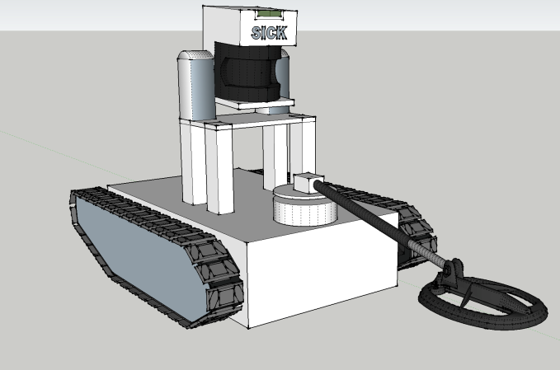
UGV* Mine Detector
Josh Genao EE/CpE
Ronald Hanifen CpE
Hernan Carvajal EE
Javier Palomo EE
Group 11
*UGV = Unmanned Ground Vehicle Sponsored By EZ Claims, Inc.

Slide 2
Motivation
Landmines kill 15-20,000 people every year (mostly children), and many countless more off record.
At the current rate of clearing land mines it will take humans thousands of years to clear all the active land mines in the world.
The current methodology of removing/deactivating land mines is extremely dangerous.
We aim to solve this by creating a robot that will handle this detection, locate these mines, and determine a clear path from start to destination

Slide 3
Project Goals
Semi-Autonomous Vehicle
  Robot Operating System Integration
  Obstacle Avoidance
    LIDAR
    GPS
  Metal Detection
  Wireless Communication
  Power Control
  Motor Control

Slide 4
Requirements
Semi-Autonomous Robot
  Utilize Metal Detector, BeagleBone Black, LIDAR and GPS to make decisions based on user input through Main Controller Unit
Obstacle Avoidance
Wireless Communication Capability
Pathfinding Algorithm to Determine Clear Path

Slide 5
Specifications
Feature | Measurement
Dimension | 11”x12” + 12” for Metal Detector
Operating Range | 300 ft
Power Supply Voltage | 3x(14.8 5000 mAh LiPo)
Maximum Payload | 20 kg
Maximum Speed | 0.3 m/s
Battery Life | 1.45 hrs (max current draw)
Recharge Time | < 6 hrs

Slide 6
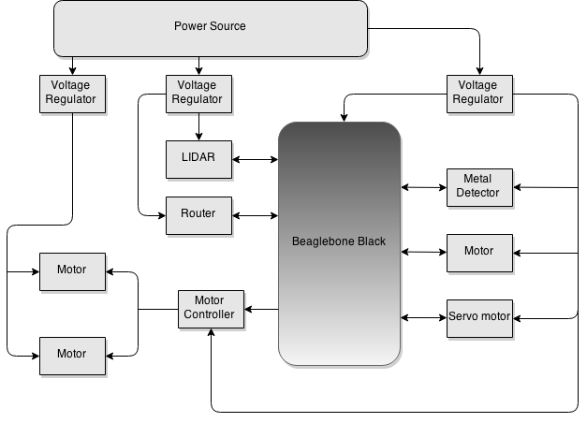
Hardware Block Diagram

Slide 7
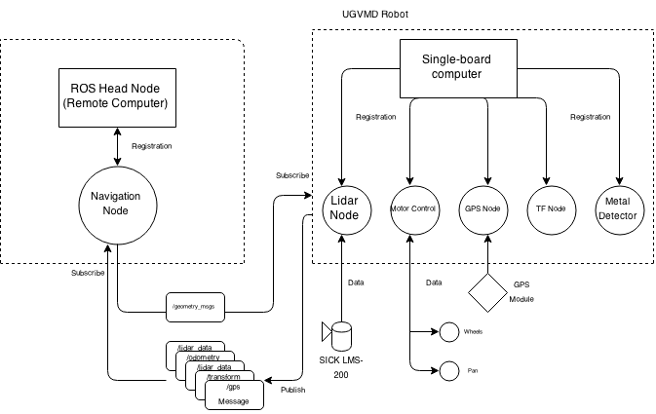
Software Block Diagram

Slide 8
Overall System
ROS
Qt Framework
Pathfinding
  Database and GPS
Power Systems
Metal Detection
Obstacle Avoidance

Slide 9



ROS
Robot Operative System
Collection of open-source software frameworks for robot software development
Allows for easier hardware abstraction and code reuse
Project will be using ROS Indigo

Slide 10
How ROS works
Comprised of multiple independent nodes communicating with each other
Uses a publisher/subscriber messaging model

Slide 11
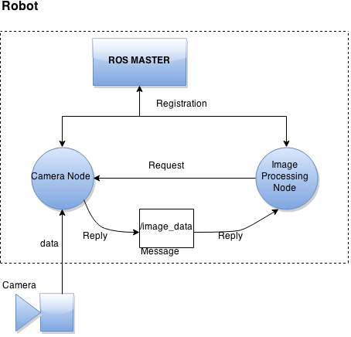
How ROS works - Example

Slide 12
How ROS works
Comprised of multiple independent nodes communicating with each other
Uses a publisher/subscriber messaging model
All nodes are registered through a Master Node
  Allows all other ROS nodes to find each other
Transporting message data uses standard TCP/IP sockets
  Also supports UDP-based message transport

Slide 13
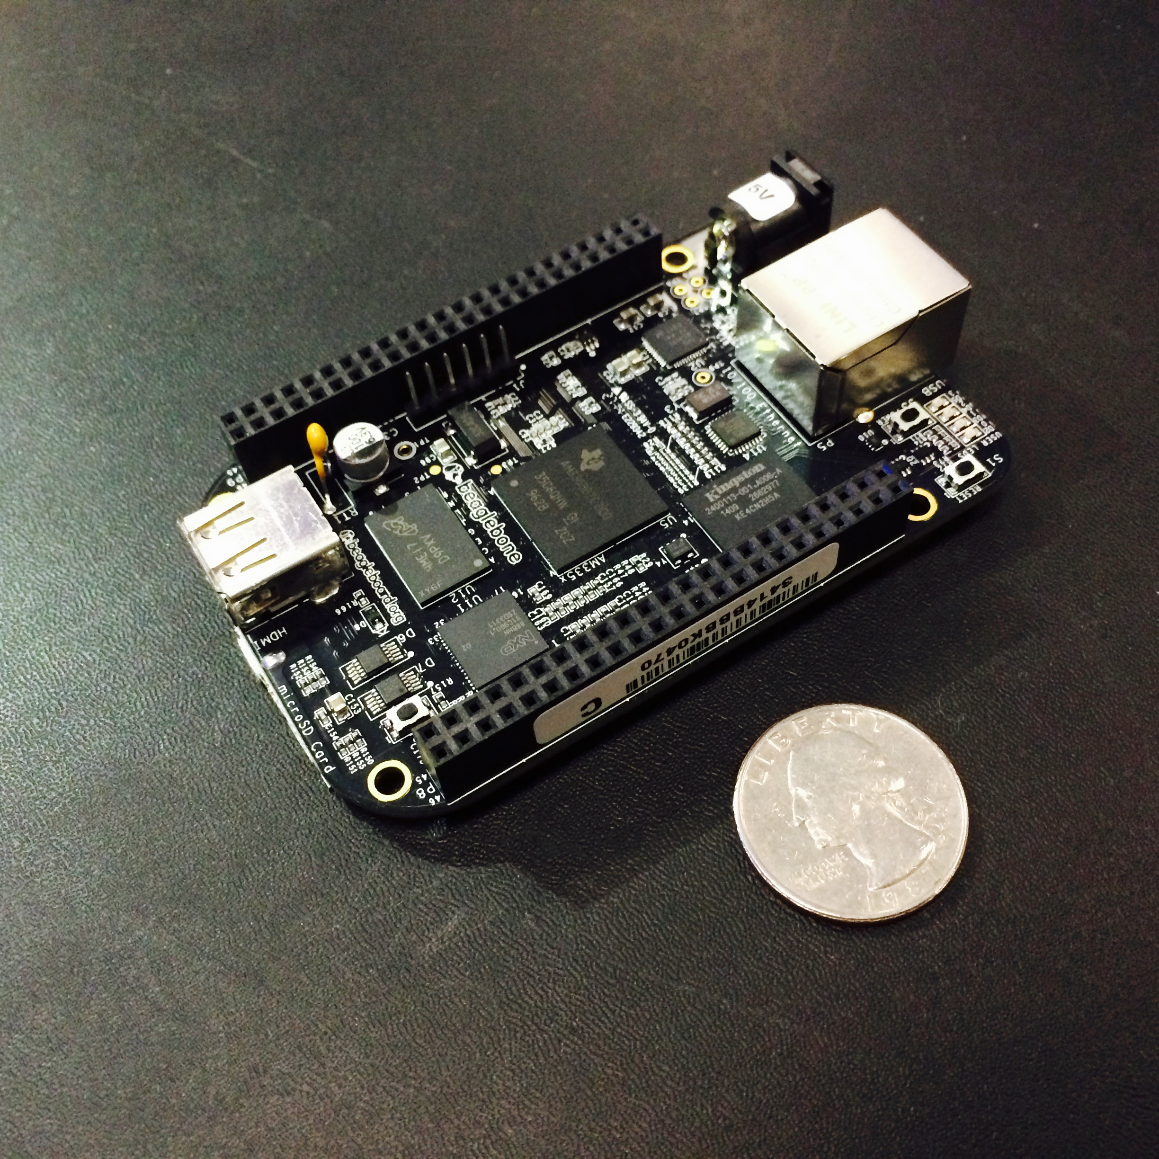
BeagleBone Black
Used to send data to MCU
Receives information from MCU to act according to surrounding conditions
Peripherals:
  LIDAR
  GPS
  Motor Controls
  Metal Detector

Slide 14
Motor Controller
Atmel ATmega328
  Control H-Bridge and Servo
  Flash 32Kbytes
  Operating frequency 20 MHz
Atmel ATmega16U2
  USB-to-serial converter
L298 Dual Full-Bridge Driver
  Dual bidirectional DC motor controller

Slide 15
Platform
Original Design
  Materials: Acrylic sheets (0.22 in thick)
    Laser cut
  Drive: VEX Tank Tread Kit
Problems
  Laser cutter not adjusted properly
  Glue didn’t work
  Vex Tank Tread Kit missing parts
Solution
  New Design or Buy pre made platform…

Slide 16
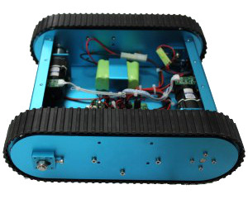
Platform
Tracked Mobile Tank Kit
  Dimensions:
    L-320mm, W-300mm, H-110mm
  Weight:
    4.3Kg
  Maximum Load:
    20Kg
  Materials:
    Aluminum alloy chassis
    Rubber Tracks

Slide 17
Platform
Advantages
Disadvantages
Stable
Light weight
Traction
Mobility
Easy to Modify
Made of Aluminum alloy
  Possible EMF interference
Expensive
Tank treads not readily available

Slide 18
DC Motors
Faulhaber 12V DC Motor
  Operating Voltage/Current: 12VDC/ 1.4A
  RPM: 8100
  Gearbox Ratio: 64:1
  Stall Torque: 11.3 oz-in
  Diameter: 30mm, Diameter of Shaft: 6mm
  Length: 42mm, Length of Shaft: 35mm
  Total Length: 85mm

Slide 19
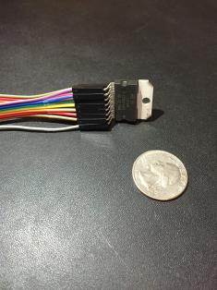
L298P/N Dual Full Bridge Driver
Inputs |  | Operation
Venable = H | A = H & B = L | Forward
 | A = L & B = H | Reverse
 | A=B | Stop
Venable = L | A = X & B=X | Free Run Stop

Slide 20
H-bridge
ST L298P Dual Full-Bridge Driver
  Number of H-Bridges = 2
  Logic Supply Voltage = 4.5V to 7V
  Power Supply Voltage = 4.8V to 46V
  Max Output Current = 2A per channel
  Output Control = PWM
  Requires external Schottky Diodes

Slide 21

Power System
Integrated Power Supply
  3 x (14.8V 5000mAh LiPo) = 14.8V 15,000mAh LiPo
    Tenergy TB6-B 50W balancing charger
  Voltage Regulation
    LM25118 12V 4A Switching Regulator
    LM25118 12V 4A Switching Regulator
    LM3150 5V 3A Switching Regulator

Slide 22
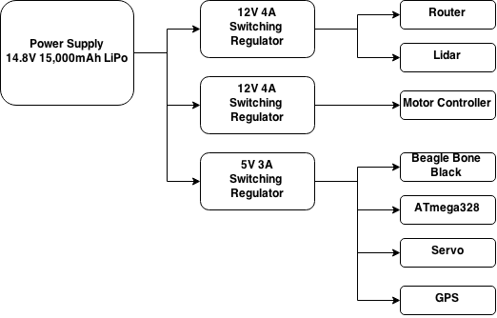
Power System

Slide 23
Power System Requirements
Component | Vout | Iout(max)
Motor Controller | 12V | 4.0A
Router | 12V | 1.0A
Lidar | 12V | 3.0A
Beagle Bone Black | 5V | 2.0A
ATmega328 | 5V | 25mA
Servo | 5V | 500mA
GPS | 5V | 20mA

Slide 24
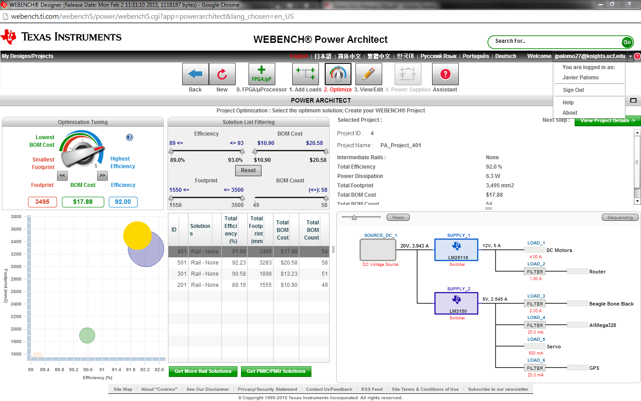

Slide 25
Detection System
Pulse Induction Metal Detector
  Brief magnetic field
  Helps reduce noise from highly mineralized soil
Double D differential coil method
  Reduce noise
  Farther reduce interference from soil
  Accurate detection
Separate Power Supply
Circuit

Slide 26
Detection System
Design
  Coils
    Use Existing Coils
  Circuit
    Power supply
    Pulse Generation
    Receiver
    Output generator
    Communication with BeagleBone

Slide 27
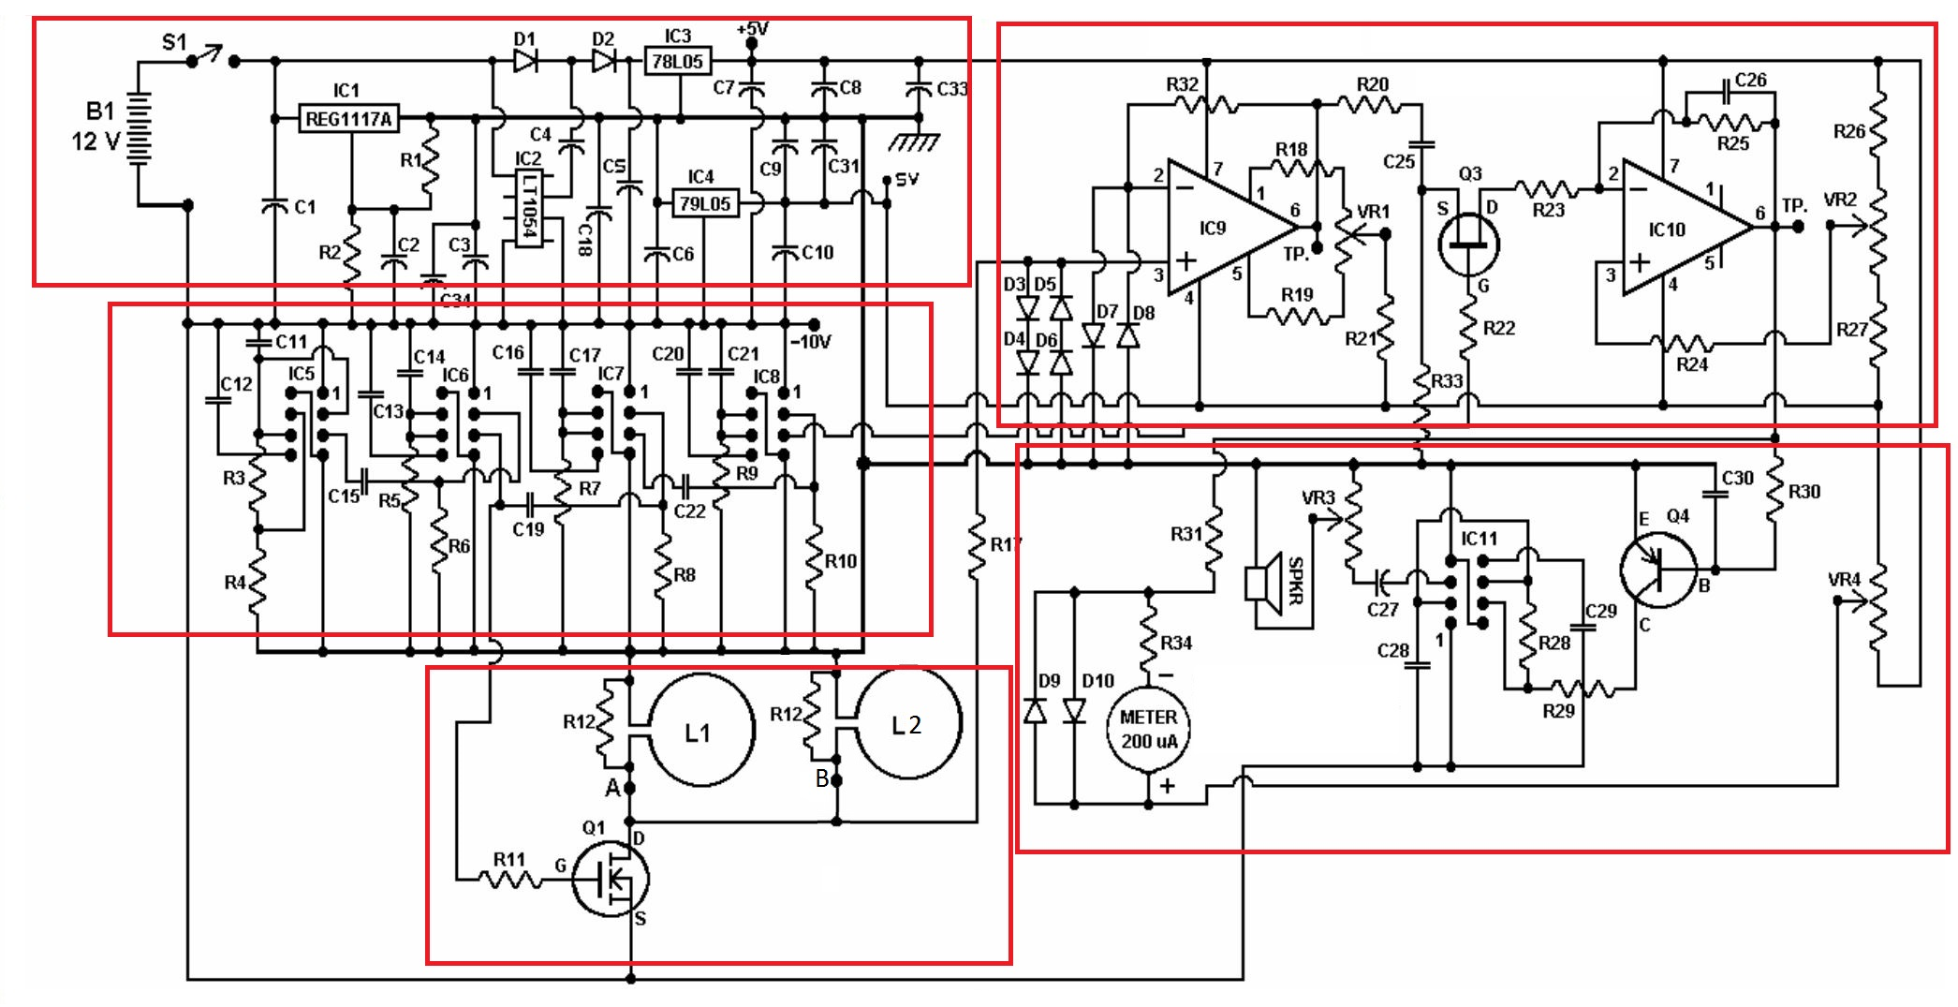
Circuit – Detection System
Power Supply
Receiver
Pulse Generator
Output generator
Coils

Slide 28
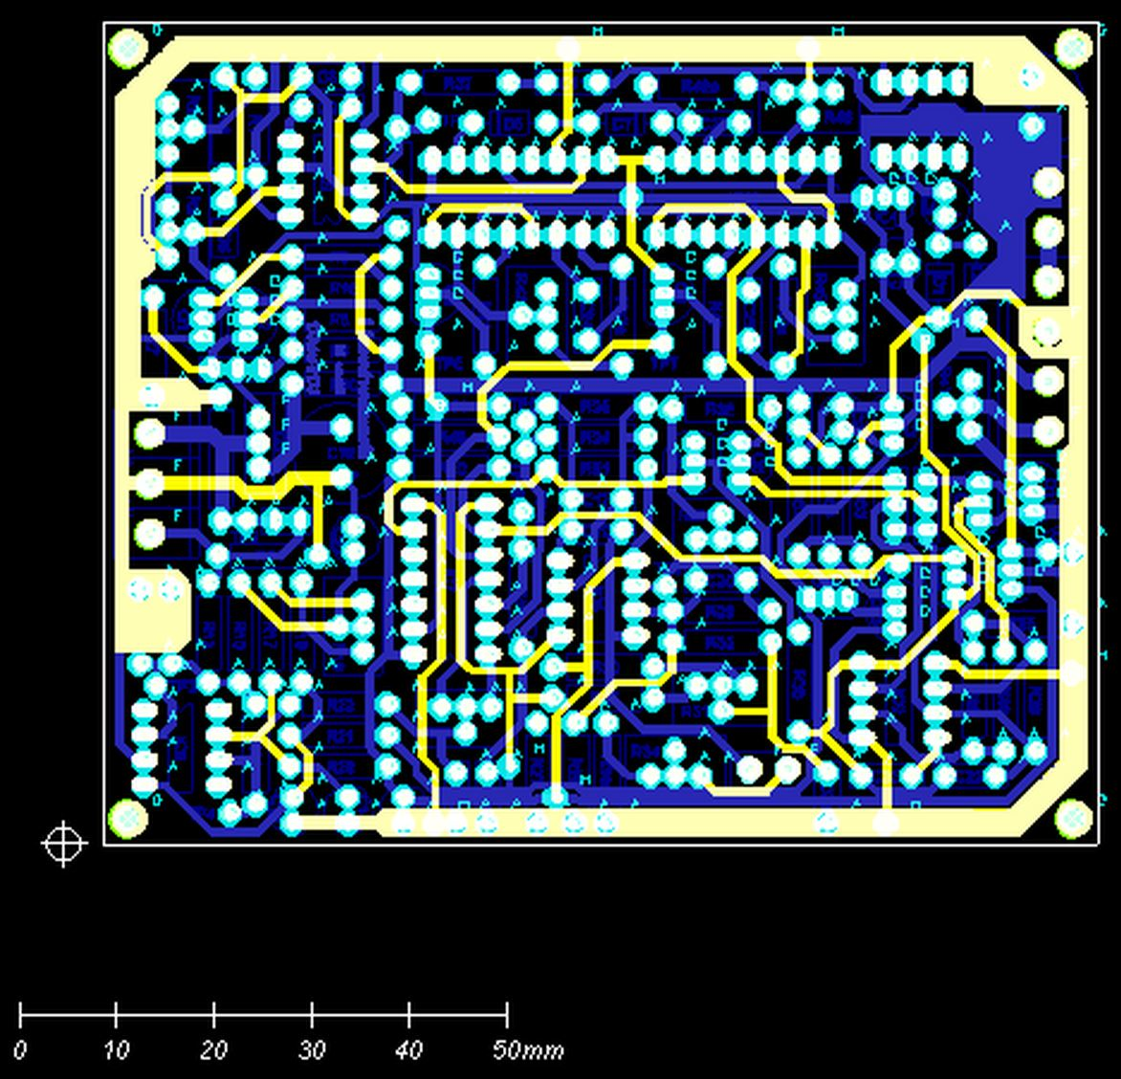
Circuit
Gerber file view of circuit

Slide 29
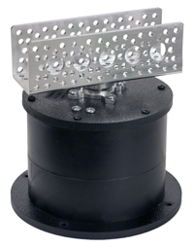
Pan System – Detection System
Hitec DDP155H Base Pan
  Fits multiple size servos
Hitec HS-5485HB standard size servo
  Operating voltage: 4.8-6.0 Volts
  Stall Torque: 72-89 oz/in
  Current drain (4.8V): 400mA no load, 8.8mA/idle
  Current drain (6.0V): 500mA no load, 9.1 mA/idle
  180 degrees operating angle
  Weight: 45g
Optimal detection sweeping speed: 0.12m/s – 1.0m/s

Slide 30
Main Control Unit
ROS Master Node
Processes the information received from the robot
Display point cloud
Display location of robot and IEDs

Slide 31


Operating System
BeagleBone: UbuntuARM Trusty 14.04 LTS
  Able to implement ROS
  Large community
  Currently booting from microSD
MCU: Ubuntu 14.04 LTS

Slide 32
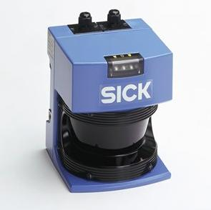
SICK LMS-200 Laser Measurement Sensor
Model Name | LMS 200-30106
Field of view: | 180°
Angular resolution: | 1, … 0.25°
Scanning Range: | 80 m
Statistical Error: | 5 mm
Data interface: | RS-232, RS-422
Supply voltage: | 24 V DC +/- 15%
Dimensions (LxWxH) | 156 x 155 x 210 mm

Slide 33
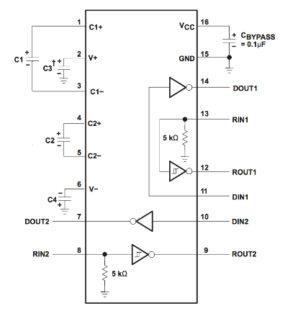
RS232 Connection
Texas Instruments MAX3232
RS-232 to TTL converter
BeagleBone UART communication needs 3.3V
V_cc = 3.3v
R_out = ± 0.3Vcc

Slide 34
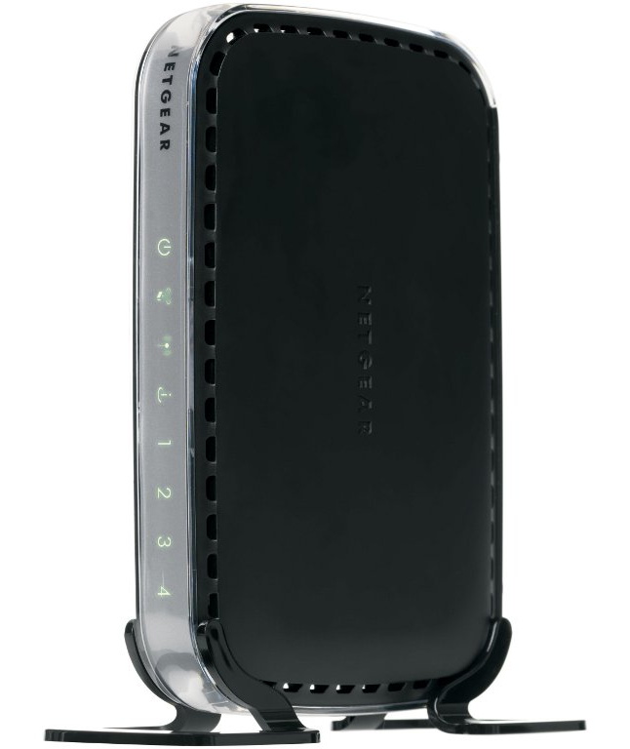
Wireless Communication
NETGEAR N150 Wireless Router
Wireless mode 802.11 g/b or 802.11n
2.4 GHz wireless connection
Used as access point
BeagleBone connected via ethernet
BeagleBone will have a static IP address

Slide 35
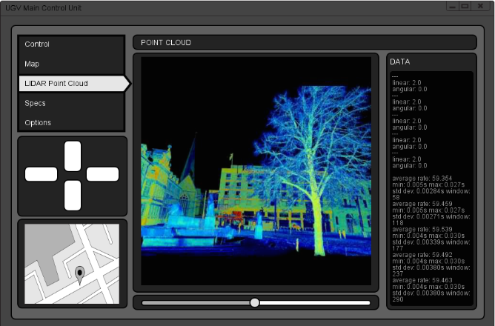
MCU Interface - GUI

Slide 36
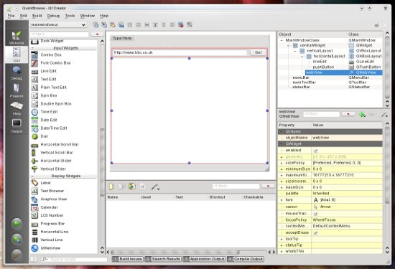
Development Environments
C++
  Qt5 Creator (QT 5)
Python 2.7

Slide 37
Pathfinding
  A* algorithm ROS node
    Primarily uses GPS information to determine clear path
  Waypoints
    Determine safe zones based on known locations of mines
    Plays into A* algorithm to help determine clear path
  Clear Path
    Robot will determine the clear path based on locations traveled, and known destination

Slide 38
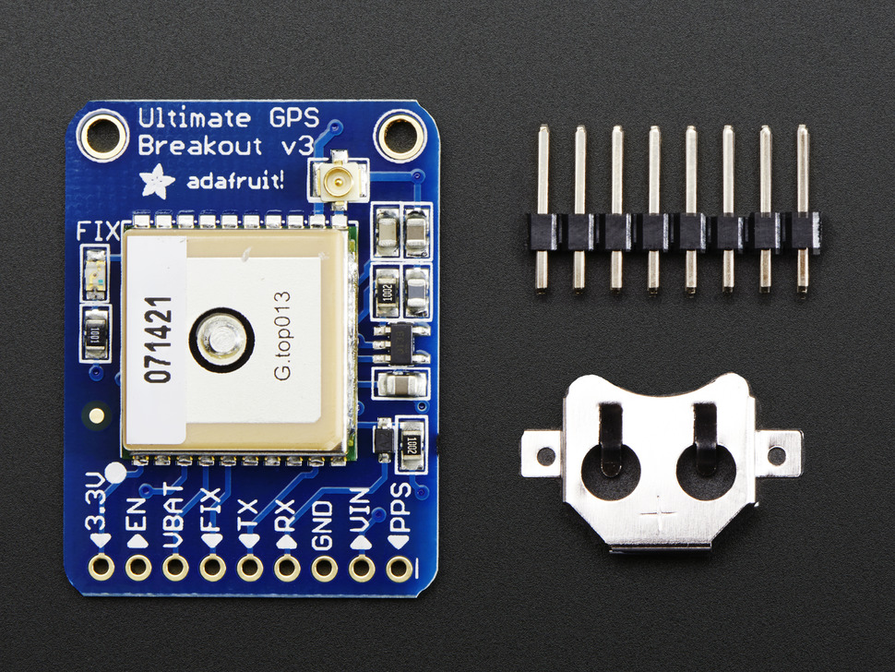
GPS
UART connection
22 tracking satellites
66 searching satellites
Position Accuracy: < 3 m
Velocity Accuracy: 0.1 m/s
GPS ROS node

Slide 39
Database Implementation
  Database will record the locations of found mines
  Database will record the locations of known safe zones
    This leans towards a relatively simple schema with just two tables recording each of these locations
  Database will constantly be queried to assure that the robot is within a safe range. This will be handled through the Pathfinding and Obstacle Avoidance ROS nodes.

Slide 40
Obstacle Avoidance
  Navigation Stack
    LIDAR
      Point cloud information to detect immediate threat obstacles
    GPS
      In conjunction with tf ROS node that determines the the position of the device relative to everything else
    Base Controller
      Motor Controls

Slide 41
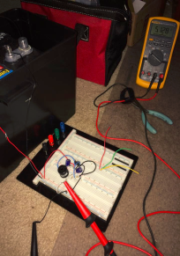
Prototyping
Completed
  Voltage Regulation
  ATmega328 (using Arduino Uno) communication to L298P Dual Motor Driver
  XV11 LIDAR transmission with Beagle Bone Black
  LIDAR Visualization Widget
In Work
  Servo Motor
  Metal Detection

Slide 42
Bill of Materials
Product # | Product Name | Description | Number of Units | Unit Price | Estimated Total Price
RB-Nex-34 | Tracked Mobile Tank | Platform | 1.00 | $719.97 | $719.97
L298P | STM Dual Full-Bridge Driver | H-Bridge | 1.00 | $4.67 | $4.67
ATmeg16U2 | Low power 8-bit RISC MCU | USB-to-Serial Converter | 1.00 | $4.39 | $4.39
ATmeg328 | 32kB 8 Bit MCU | Micro Controller | 1.00 | $3.51 | $3.51
1N5819 | Schottky Diode 40V 1A | Diode | 10.00 | $0.36 | $3.60
15019 | Venom 25C 4S 5000mAh 14.8 LiPO | LiPo Battery | 3.00 | $72.67 | $218.01
B00466L0BW | Tenergy TB-6 50W Balancing Charger | Battery Charger | 1.00 | $45.99 | $45.99
1996 | Element-14 Beagle Bone Black | Rev-C | 2.00 | $55.00 | $110.00
746 | Ada Fruit Ultimate GPS | Breakout-66 Channel with 10Hz Update | 1.00 | $35.95 | $35.95
1015850 | SICK LMS 200 | Lidar Detection System | 1.00 | $399.99 | $399.99
LM25118 | Wide-Vin Synchronous Buck Converter | Simple Switching Regulator | 2.00 | $5.40 | $10.80
LM3150 | Wide-Vin Synchronous Buck Converter | Simple Switching Regulator | 1.00 | $4.02 | $4.02
276 | Switching Power Suppy | 5VDC 2A | 1.00 | $7.95 | $7.95
WNR1000 | Netgear N150 Wireless Router | Router | 1.00 | $0.00 | $0.00
Total |  |  |  |  | $844.21

Slide 43
Work Load Spread
Task | Ron | Josh | Hernan | Javier
Power Regulation |  |  |  | X
Motor Controller |  |  |  | X
Metal Detection |  |  | X
Platform |  |  | X
LIDAR |  | X
ROS Development | X | X
MCU Development | X | X
Path finding | X

Slide 44
Current Progress

Slide 45
Questions?

